Slide 1

Teaching English Language
Dr Namrata Majhail
Date:20.08.22

Slide 2

Energiser- Do we know our alphabets?

Slide 3
https://www.youtube.com/watch?v=JsuqnzqZimQ

Slide 4
KWL CHART
K : What I already KNOW about the topic | W: What I WANT to know about the topic | L: What I LEARNT about the topic
Name of Teacher | Subject: | Grade & Section
 | Topic: | Date:

Slide 5


Slide 6
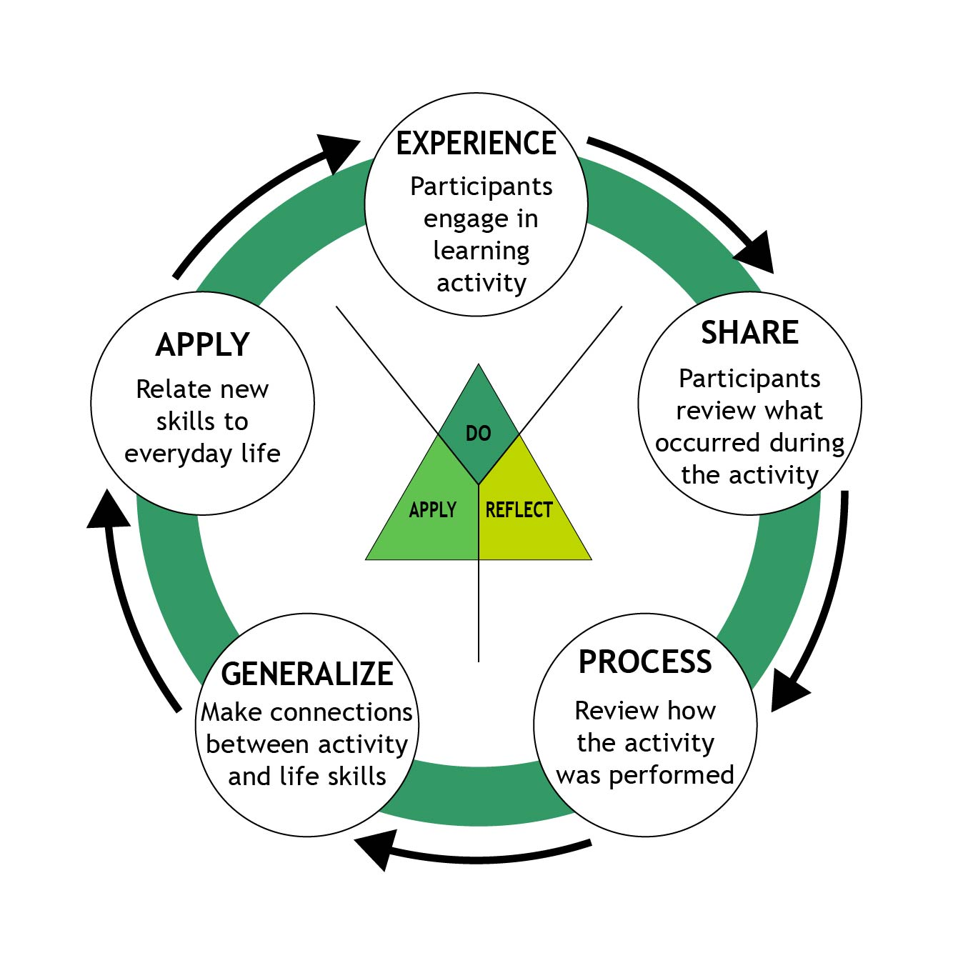

Slide 7
Activity #2-Role Play
Choose a topic and teach in a unique way

Slide 8
Short Break

Slide 9
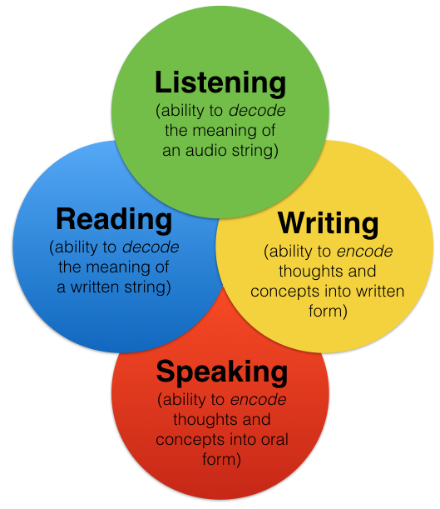
Let’s revise!

Slide 10
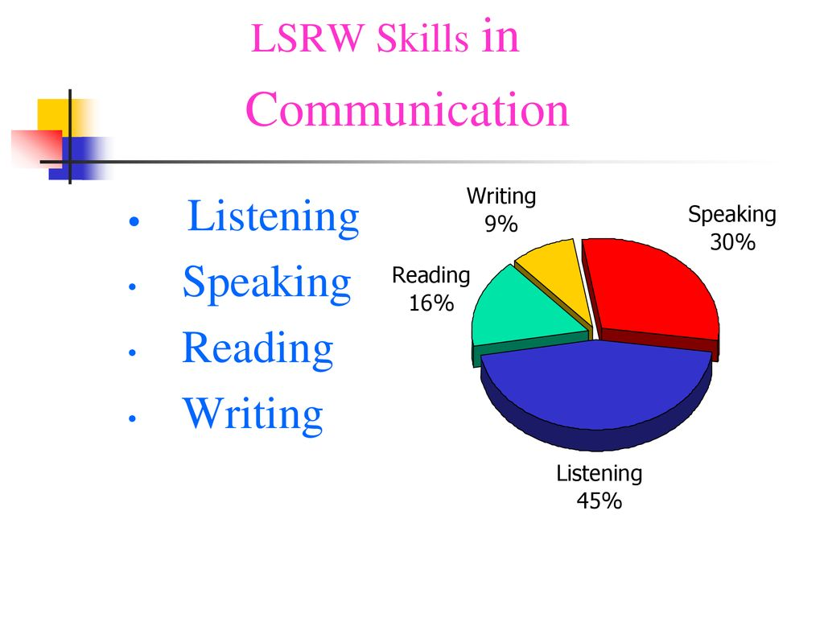

Slide 11
Training Session: Teaching English through Experiential Learning
ACTIVITY #2 Creating an Activity-LSRW
Topic: Class:
Objective/s 1. 2. 3. 4. Rubrics:
1. | 2. | 3. | 4. | 5.

Slide 12
Lunch Break 30 minutes!

Slide 13
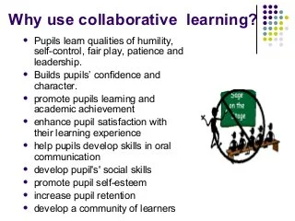

Slide 14
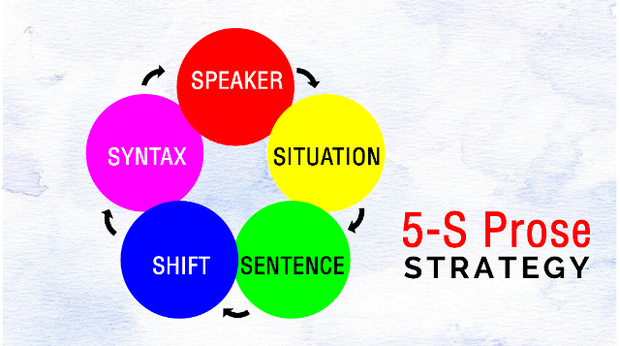

Slide 15


Slide 16
CBSE Manual
https://cbseacademic.nic.in/web_material/CurriculumMain23/SrSec/English_core_SrSec_2022-23.pdf

Slide 17
Activity #3

Slide 18


Slide 19
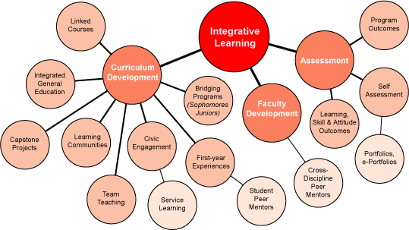

Slide 20
TOPIC:
A.POSSIBLE AREAS OF INTEGRATION:
B.POSSIBLE SUBJECTS FOR COLLABORATION (FEEL FREE TO ADD /DELETE SUBJECTS)
Subject/s | Points for collaborative projects with name of the topic/s
1.Social Science 2.History 3.Science 4. 5.
Area of Integration
ICT Performing art Visual Art PE
Activity #4 Planning collaboration and integration

Slide 21


Slide 22
Questions Please!

